Slide 1
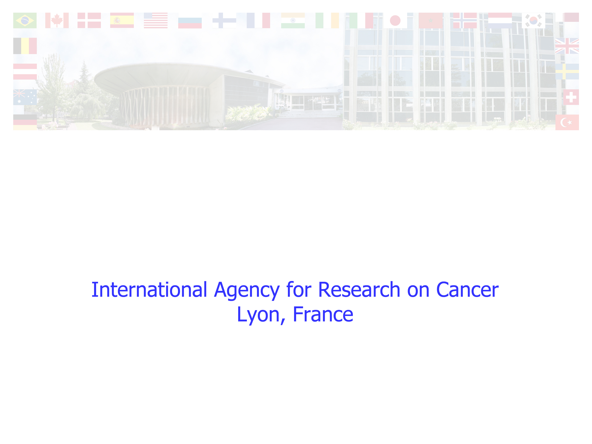
The IARC Monographs:
Volume 112, Glyphosate Evaluation
Kate Z. Guyton PhD DABT
Senior Toxicologist
Responsible Officer, Volume 112
Monographs Programme

Slide 2

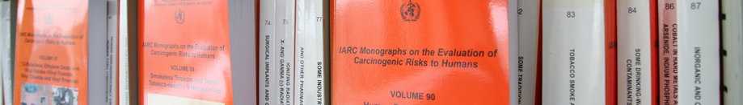
IARC Evaluation of Glyphosate
Probably carcinogenic to humans (Group 2A)
IARC evaluations are used as a reference worldwide
  All data are in the public domain for independent scientific review
  Reviewed by the world’s leading experts without vested interests
What happens after IARC identifies a carcinogen?
  Risk assessments help regulators and the public understand the extent of potential cancer risk
  Measures to reduce exposures

Slide 3
Scientific engagement:
Glyphosate Monograph
Monograph
in-person meeting
(3-10 March 2015)
Meeting announced (March 2014):
Preliminary List of Agents
Call for Data and Experts
Request for Observer Status
WHO CoI form posted
Participants (and DOI) announced
(Jan. 2015)
The Lancet Oncology
publication
(March 2015)
References shared with health agencies
(April 2015)
Glyphosate Monograph
publication
(July 2015)
IARC meetings are open and follow transparent, published methods
All meeting participants have full access to the data being evaluated
Fully referenced Monographs published on-line for free download

Slide 4

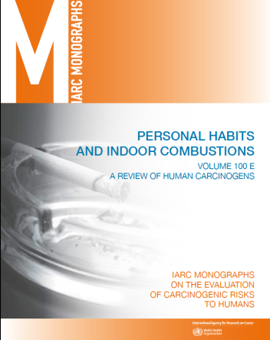
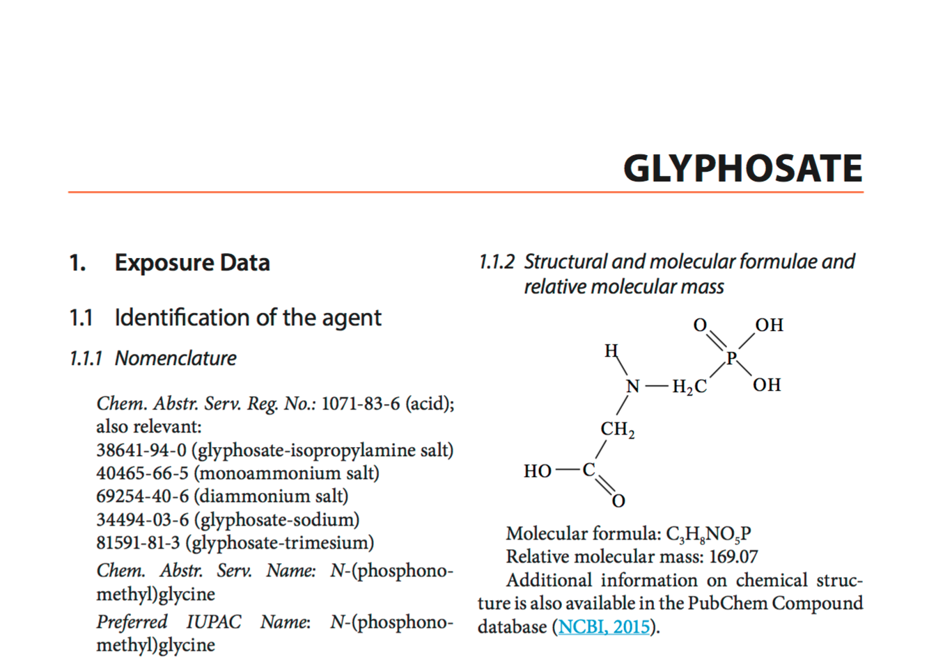
How was glyphosate evaluated?
~1000 studies identified and screened
Laboratory studies
  “Pure” glyphosate, glyphosate formulations
    Cancer in mice, rats
    DNA damage (genotoxicity)
Human studies (real-world exposures)
  DNA damage– community
  residents before and after spraying
  Cancer in humans– farmers, other workers
  Published Monograph: >250 references

Slide 5
Cancers in mice fed glyphosate
Positive results in 2 of 2 feeding studies
Rare cancers: extremely important in assessing human risk….but challenging to detect signal from background noise
  High statistical significance
  Benign, malignant cancers; no toxicity
    Evaluation fully in line with accepted principles
    Sufficient evidence of cancer in animals

Slide 6
Damage to DNA (Genotoxicity)
Residents in sprayed communities
DNA and chromosome damage in blood
Strong evidence, glyphosate formulations:
Exposed community residents
Experiments using:
  Human cells
  Animal cells
  Mammals and non-mammals
  Negative in bacteria
Strong evidence, glyphosate:
No studies in exposed humans
Experiments using:
  Human cells
  Animal cells
  Mammals and non-mammal
  Negative in bacteria

Slide 7
Human cancer studies (NHL)
Studies of exposed workers provide “limited” evidence for NHL (Non-Hodgkin lymphoma, a rare type of cancer)
1) Case-control studies
Sweden, Canada, US
2592 NHL cases
Increased risks, not explained by other pesticides
2) Cohort study
(Ag Health Study)
US, 2 states
92 NHL cases
No significant increase in risk
3) Meta-analysis
Objective method to combine all studies
Increased risks

Slide 8

Summary: glyphosate hazard evaluation
Cancer in
experimental animals
Sufficient evidence
Studies of pure glyphosate
Rare cancers in valid studies
DNA damage & other relevant data
Strong evidence
Studies of real-world exposures
Experimental studies of pure glyphosate
Experimental studies of glyphosate formulations
Cancer in
humans (NHL)
Limited evidence
Studies of real-world exposures
Glyphosate formulations in different regions at different times
Overall evaluation of glyphosate:
Group 2A Probably carcinogenic to humans

Slide 9
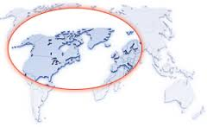
Question 1: What causes cancer, glyphosate or formulations?
Real-world exposures to formulations, BUT… similar increases in the same type of cancer (NHL) in:
  Different geographic regions
  Different times
Studies of “pure” glyphosate:
        Sufficient evidence for cancer in animals
        Strong evidence of DNA damage (genotoxicity)
    “Glyphosate” is probably carcinogenic to humans

Slide 10
Question 2: How was the US AHS study weighed in the evaluation?
AHS is one of the largest studies of pesticides and cancer, BUT…
  Not the largest study of NHL (fewer NHL cases)
  Short follow-up time
      Limited ability to detect rare cancers
Increased risk in case-control studies
Increased risk in combined data from all studies
The AHS does not negate other studies
Altogether, the evidence is “limited”

Slide 11
Question 3: What do unpublished toxicology studies show?
Some industry toxicology studies considered by IARC were not evaluated (not in the public domain in sufficient detail for independent review)
  Cancer studies in rodents: cancers were reported, full data needed to verify
  Additional negative “guideline” studies (e.g., in bacteria) (consistent with IARC conclusion)
  No additional studies in exposed humans, human cells
IARC has requested and encourages full public data release for independent scientific review

Slide 12
Question 4: What happens next?
What usually happens after IARC classifications?
  A risk assessment- to help understand level of risk with exposure in different settings
  Public health action to limit exposure to workers and the general public
Does IARC make policy recommendations?
  No. It remains the responsibility of national and international agencies to limit exposures to carcinogens identified by IARC.

